Slide 1
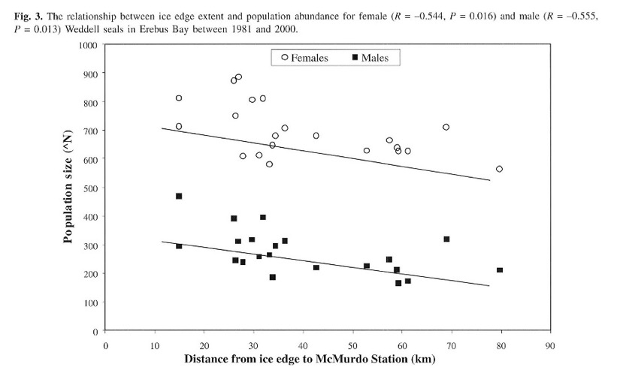
Ice POD: Weddell Seal Data
Based on the graph, what relationship can you make about the number of Weddell Seals (x axis) and the how close the ice edge was to McMurdo Station (y axis)?
Cameron & Siniff 2004; Proffitt et al. 2007, 2008
Ask questions in the “Ask the Team” section of today’s journal.
Notes:
This relationship was shared at a science presentation given by Dr. Burns. As the distance between the ice edge and McMurdo Station grows smaller (i.e., as the ice melts) there are slightly higher populatinos of male and female seals. As the distance between the ice edge and McMurdo Station increases, the population of seals decreases slightly.
Learn more about life and work in Antarctica, and ask the team questions by going to this journal: https://www.polartrec.com/expeditions/human-impacts-in-antarctica-2015/journals/2015-12-05

